Slide 1
Project CSE2001
Object Oriented Programming with C++
By Ankit Singh 24BCE10242

Slide 2
Type2C
A multiplayer typing test game implemented in C++ using socket programming.

Slide 3
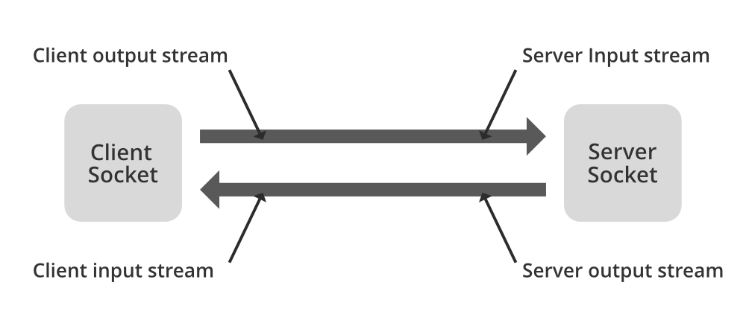
Why did I choose this project?
To learn socket programming and create an engaging application.
To understand real-time communication between clients and servers.

Slide 4
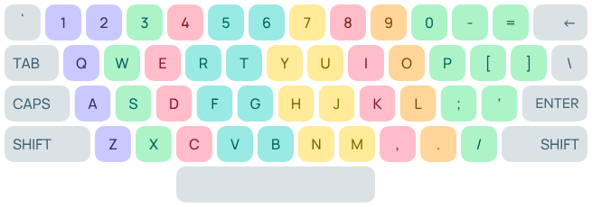
Objective
Build a multiplayer typing test game.
Measure typing speed (WPM) and accuracy.
Enable cross-network play using IP-based connections.
Secondary Objectives:
Improve error handling and ensure smooth gameplay.
Make the project cross-platform (Windows/Linux).

Slide 5
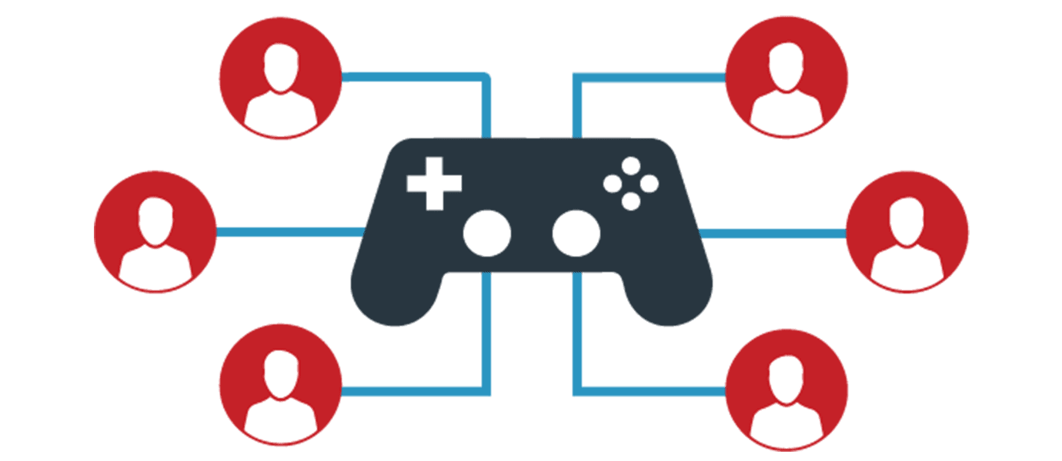
Features
Multiplayer support for two players.
Real-time communication between clients and server.
Cross-network play using the server’s local IP address.
Calculates WPM and accuracy for each player.
Displays results to both players after the game ends.

Slide 6
System Architecture : Client-Server Model
Server:
Waits for client connections.
Sends the typing text to both clients.
Receives results from clients and broadcasts them back.
Clients:
Connects to the server using its IP address.
Receive the typing text, calculate WPM/accuracy, and send results back.

Slide 7
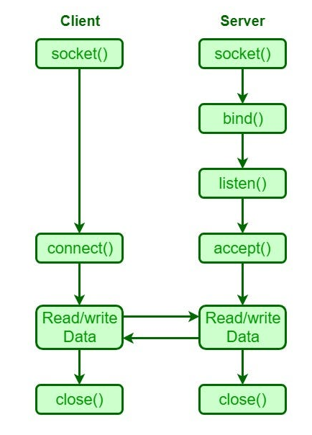
Implementation
Server:
Binds to the local IP and listens for connections.
Accepts 2 client connections and starts the game.
Sends a random text to both clients for typing.
Collects results (WPM & accuracy) from clients.
Broadcasts final scores to both players.

Slide 8
Implementation
Client:
Connects to the server using its IP address.
Receives the text to type from the server.
Measures typing time, calculates WPM/accuracy, and sends results back to the server.

Slide 9

Code Implementation
Server code:
int clientSocket= accept(serverSocket, …);
send(clientSocket, “START| The quick brown fox…”, …);
recv(clientSocket, buffer, …);

Slide 10

Code Implementation
Client code:
connect(clientSocket, …);
recv(clientSocket, buffer, …);
send(clientSocket, “FINISH|45|98”, …);

Slide 11
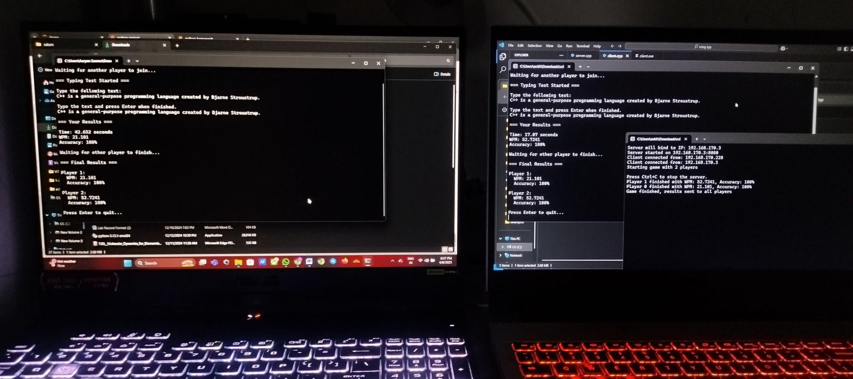
Demo
Start server.exe on one computer
Run client.exe on two devices in the same network
Enter the server’s IP address when prompted on each client.
Type the provided text as quickly and accurately as possible.
View results displayed on both clients after completion.

Slide 12
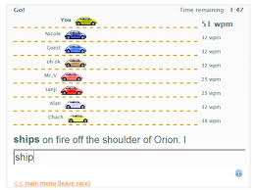
Future Enhancements
Add support for more than two players in a single game session.
Implement real-time progress tracking during gameplay
Add difficulty levels or custom text input options for practice sessions
Create a leaderboard system to track high scores across multiple games.
Inspiration: TypeRacer

